Slide 1
Classical Music Generation
by Richard Harrison

Slide 2
Problem and Data Description
Given a simple prompt from a user, automatically generate notes for a classical song.
The dataset is 1,325 songs scraped from midiworld.com which consists of about 1.5 million notes.
The file types in their raw form are .mid. These were converted to tabular data where one note has information for pitch, step, duration and start and end times.
pretty_midi library was used to make the conversion
So we have Supervised Regression ML Problem
Applicable for content creators and any business with “background music”

Slide 3
ETL and Data Wrangling
Slightly messy work scraping the midiworld website using BeautifulSoup
Once downloaded and converted to tabular data, the data was pristine, no NAs or other issues that I’m aware
Extracted only pitch (perceptual quality of sound), step (time elapsed from previous note or beginning of song) and duration (duration of note).

Slide 4
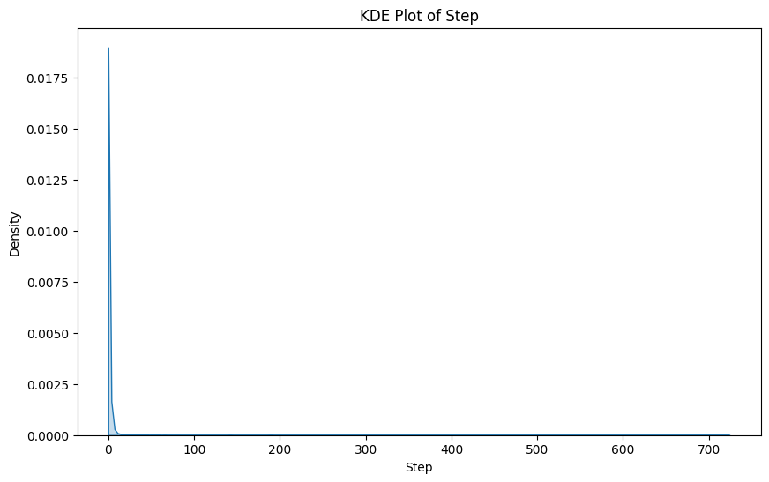
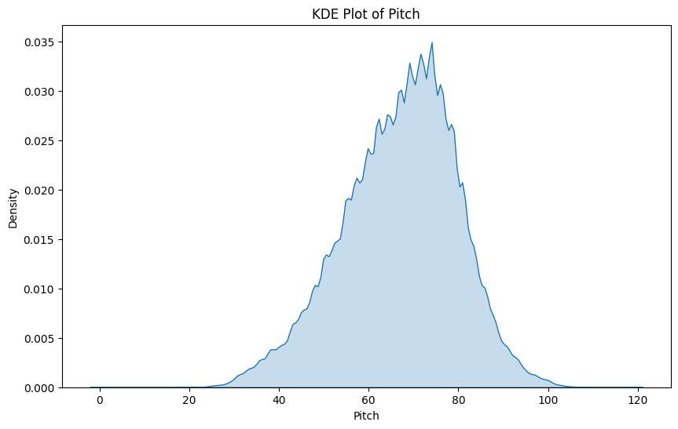
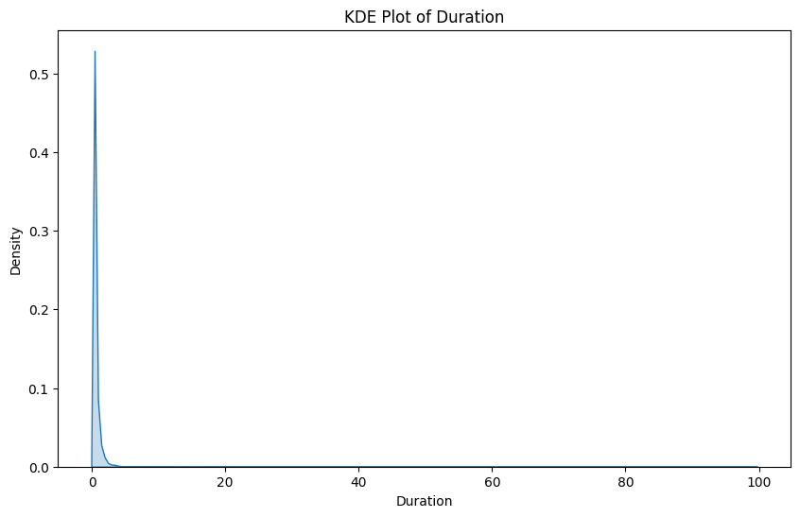
EDA
Pitch looks normal, step and duration are positively skewed

Slide 5
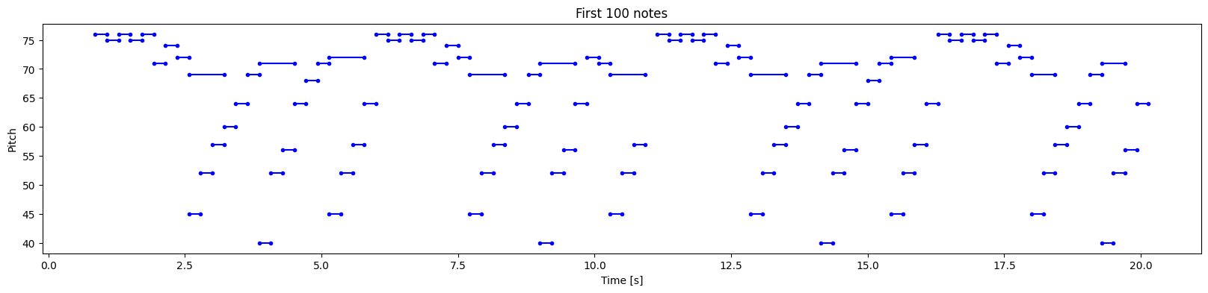
EDA
Plot of timestep vs pitch with length of bars representing duration of note

Slide 6
Modeling
Used 25 note sequences as features with the next note as target
Started with a medium complexity model which was a single layer LSTM with 128 neurons then built more complex with 2x 128 neuron LSTMs and last model was a simpler 32 neuron LSTM.
For step and duration, I used a custom loss function based on mean squared error that encourages the model to output non-negative values.

Slide 7
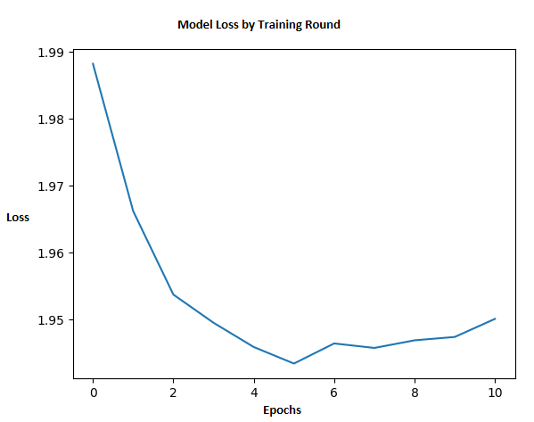
Modeling
Typical for each model, this plot shows loss as a function of epochs
I used a weighted MSE loss which gave pitch a 0.05 weight and step and duration 1
Reason is because of mismatch of scale between them

Slide 8
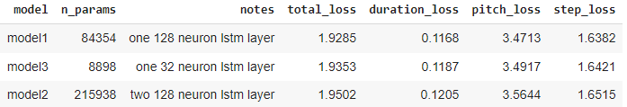
Hyper-Parameter Table
The deepest model has the worst performance according to total MSE with medium complexity model having the best
Note that this is not really what we’re interested in anyways and the difference in loss between the 3 is small

Slide 9
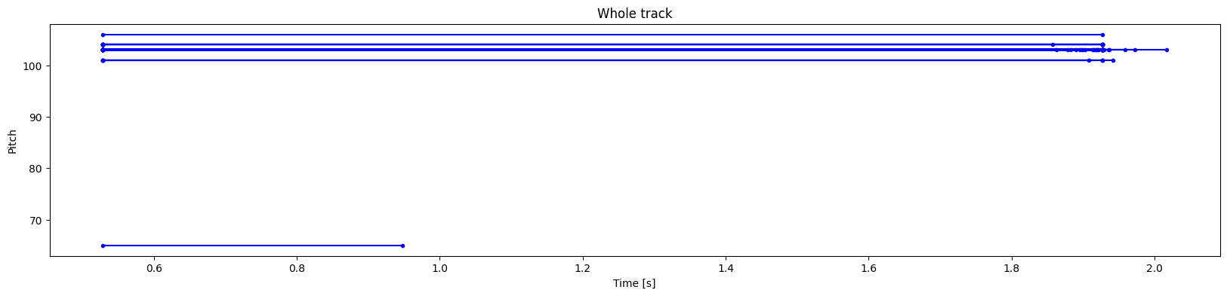
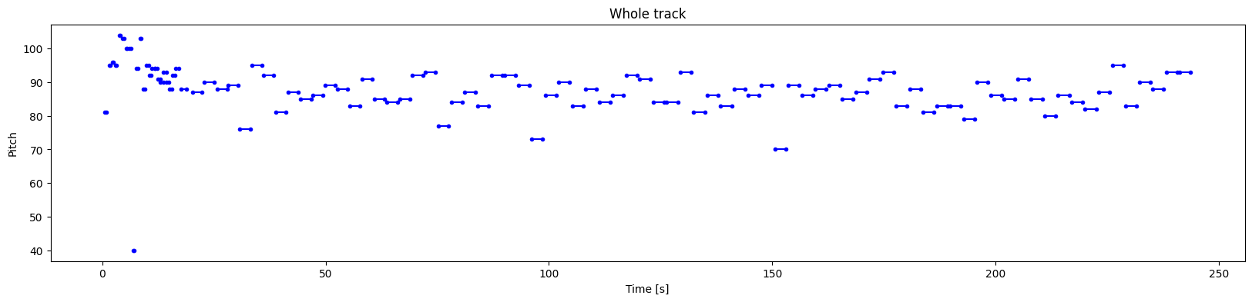
Conclusion
Simple
Even though the most complex model had the worst MSE performance, it generated the most elegant music of the 3 by a landslide
The simplest model had significantly worse generative abilities than the other two
See a sample of the time vs pitch plot for the complex and simple models to get an idea
Complex

Slide 10
Future Work
Increase model complexity and use different sequence lengths of notes for training would be the obvious first choice
Automatic scoring of the music based on quality. Possibilities include using embeddings from model for sequences of notes, rate them using my judgment, train a logistic regression and use that
Deploy the model as an app, take a simple user input, and generate songs automatically

